Slide 1
UIL A+ Academics
Anne Sullivan Elementary
2019-2020

Slide 2
Resources
Students may obtain practice materials from https://uiltexas.org/aplus/events
Judge evaluation sheets
Music lists
Art lists
Number sense practice tests
Creative writing pictures
Etc.

Slide 3
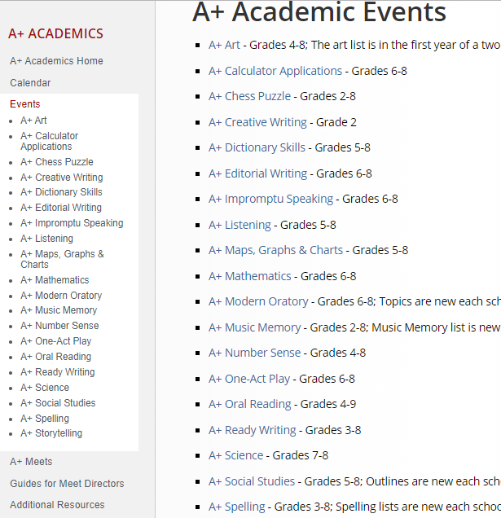
You will see many categories. Fort Bend ISD elementary schools are only participating in 6 events

Slide 4
4th and 5th Graders
Number Sense
Art History
Oral Reading
Music Memory (5th, 3rd & 4th, 2nd )
* 3 contestants and 2 alternates will be chosen for each team.
*Students may try out for all four. In the event a student is selected for all, we will have the student pick one event.

Slide 5
Number Sense
Number Sense students will be given a fill-in-the-blank test which they shall complete without doing calculations on paper or on a calculator. Erasures, mark-overs and mark-outs are not permitted. Requirements for numeric forms shall be as specified in official contest procedures. Exactly 10 minutes shall be allotted for the testing period exclusive of time required for instructions. There are a total of 80 problems on the test.

Slide 7
Number Sense Scoring
Each test should be independently scored twice, and papers contending to place should be scored a third or fourth time as needed. Five points are awarded for each problem solved correctly. Four points are deducted for each problem not solved correctly and for each problem skipped. No deduction is taken for problems after the last problem attempted. An illegible figure constitutes an incorrect answer. The contest director, with the assistance of graders, may determine whether a figure is legible.

Slide 8
Art
This contest involves the study of paintings from the National Gallery of Art in Washington, D.C. and paintings or pictures from selected Texas museums. The Art Smart Bulletin, published every other year, is the source for study of history and art elements relative to the 40 art selections and is the final authority in the spelling of artists' names and titles of art works. As part of their study, students will demonstrate an understanding of art history and interpret ideas and moods in original artworks while making informed judgments about the artwork.

Slide 9
Art
Part A of the contest requires the contestant to identify the names of 15 selected artists and titles of pictures selected randomly by the director from the official list of 40 pictures.
Part B consists of 30 questions about art history and art elements characteristic of the 40 art selections.
Tryouts will only include Part A. Students will identify 10 paintings and the artists. Students will be given 1 minute per painting.

Slide 10
Art Scoring
A perfect score is 120. In Part A, award two points if the artist's name is correct; award one point if the artist’s name is correct but misspelled. Award two points if the title of the art is correct; award one point if the title of the art is correct but misspelled.
In part B, award two points for each correct answer. Do not deduct points; simply award no points for incorrect or unanswered items

Slide 11
Oral reading
Oral Reading students will read a selection of poetry. Each selection may be one poem, a cutting of a poem, or a combination of poems. The same selection may be read in all rounds, but different selections are permissible. Selections must be published although the poet may be unknown or anonymous. The maximum time for each presentation is six minutes. There is no minimum time limit. Students who exceed the allotted time shall be penalized one rank. For example, if the judges rank a student second who has gone overtime, that student shall be assigned third place and the student who was ranked third will be given second place. Contestants may not use costumes or props in the contest. No speaker may be coached or prompted in any manner during the presentation.

Slide 12
Oral Reading tryouts
Students will read a poetry selection of their choice. It must be a published piece of poetry. Students will have1-1/2 minutes to read their selection.
The evaluation criteria has been developed to feature each element of the oral reading situation: the text, the performer, the audience and the combination of all of these – the performance.

Slide 13
Music Memory
The focus of the Music Memory contest is an in-depth study of fine pieces of music literature taken from a wide spectrum of music genres to expose students to great composers, their lives and their music. In the course of preparing for the contest, students should be given the opportunity to describe and analyze the music, relate the music to history, to society and to culture, and to evaluate musical performance.

Slide 14
Music Memory
Students will listen to approximately 20 seconds of up to 20 musical selections and identify the name of the major work, selection and the name of the composer.
To receive full credit for an answer, all information about the music selection must be complete as shown on the official list. Spelling and punctuation are considered in the grading of this contest.

Slide 15
3rd-5th Music Memory Tryouts
Students will listen to 10 selections chosen from the official Music memory list.
20 seconds of each musical piece will be played.
two points will be awarded for the correct major work, two points for the correct composer, and two points for the correct selection. If a tie-breaker is required, 1 point will be deduced for misspelling of the major work and/or 1 point for the correct selection.

Slide 16
2nd and 3rd graders
Storytelling
Music memory
Creative writing (2nd grade only)
*In the event a student is selected for more than one event, we will have the student pick one event.

Slide 17
storytelling
Storytelling contestants will listen to a storyteller read a brief story (between 600 and 1100 words long) only once, and then retell that story in their own words before a judge or judges. Contestants shall not use costumes or props in the contest. No materials or notes may be used during the presentation. There is no minimum or maximum time limit for the presentation*. Contestants may not receive prompting of the story plot or details.
*at tryouts, students will be allotted 3 minutes to retell story

Slide 19
2nd graders only
Creative Writing

Slide 20
Creative Writing
Creative Writing contestants will be given a prompt with several captioned pictures. From these pictures, the students will create an original story based on their selections. The stories shall contain at least one of the pictured items, but it is not required that all items on the page be included. Thirty minutes* will be allotted for writing exclusive of time required for instructions.
*For tryouts, students will be given 15 minutes to write.

Slide 22
Music Memory
The focus of the Music Memory contest is an in-depth study of fine pieces of music literature taken from a wide spectrum of music genres to expose students to great composers, their lives and their music. In the course of preparing for the contest, students should be given the opportunity to describe and analyze the music, relate the music to history, to society and to culture, and to evaluate musical performance.

Slide 23
2nd Grade Music Memory Tryouts
Students will listen to 5 selections chosen from the official Music memory list.
20 seconds of each musical piece will be played.
two points will be awarded for the correct major work, two points for the correct composer, and two points for the correct selection. If a tie-breaker is required, 1 point will be deduced for misspelling of the major work and/or 1 point for the correct selection.

Slide 24
Tournaments
Invitational Meet – Saturday, December 14th
District Meet – Saturday, April 4th
For all teams, there will be 3 contestants chosen with 2 alternates. The contestants will participate in the December 14th meet. The coach will determine which 3 of the 5 team members will compete in the final meet in April.

Slide 25
Students interested in trying out
Must provide two teacher recommendations. – Due No later than October 10th
Must be committed to the academic team through the remainder of the 2019-2020 school year.
Must attend a weekly practice session.
in addition to weekly practice sessions with their coach, team members Must be willing to practice independently and complete homework assigned by their coach.

Slide 26
Tryout Day – October 17th
Number Sense – 4th and 5th graders From 3:50 – 4:00
Oral Reading –4th and 5th graders from 4:10 – 5:00
Music Memory - 2nd through 5th grades from 4:15 – 4:30
Storytelling – 2nd and 3rd graders from 4:00 – 5:00
Creative Writing – 2nd graders from 3:50 – 4:05
Art – 4th and 5th graders from 5:00 – 5:15
A panel of 3 to 5 judges will score and rank the students.
The top 5 students from each category will form that team.

Slide 27
Questions?

Slide 28
Thank you for coming!
We are looking forward to showing off our Dalmatian pride at UIL A+ Academics!

